Slide 1
General Guideline
© (2021) ABES Engineering College.
This document contains valuable confidential and proprietary information of ABESEC. Such confidential and proprietary information includes, amongst others, proprietary intellectual property which can be legally protected and commercialized. Such information is furnished herein for training purposes only. Except with the express prior written permission of ABESEC, this document and the information contained herein may not be published, disclosed, or used for any other purpose.

Slide 2
References
“Fundamentals of data structure in C” Horowitz, Sahani & Freed, Computer Science.
“Fundamental of Data Structure” ( Schaums Series).
Robert Kruse, Data Structures and Program Design , Prentice Hall, 1984.

Slide 3
INTRODUCTION TO STACK

Slide 4
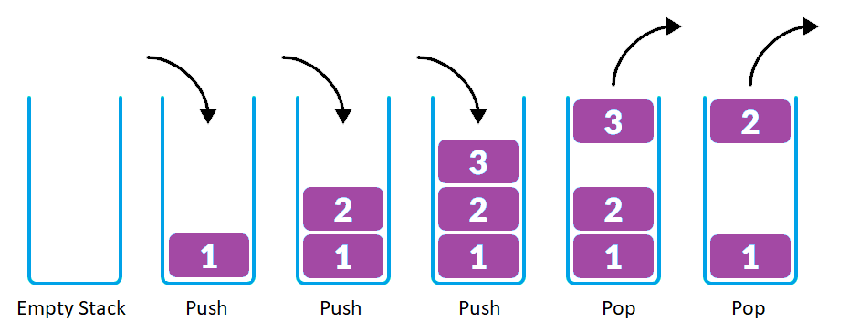
Introduction to Stack
A stack is a conceptual structure consisting of a set of homogeneous elements and is based on the principle of last in first out (LIFO). Stack is a data structure where elements can be inserted and deleted from one end only known as ‘Top’ of the Stack.
Insertion in Stack is given a standard name Push and deletion is given a standard name Pop.

Slide 5
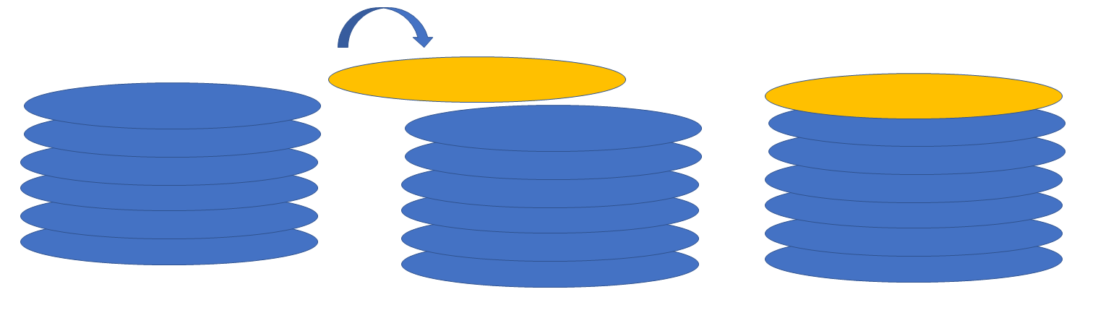
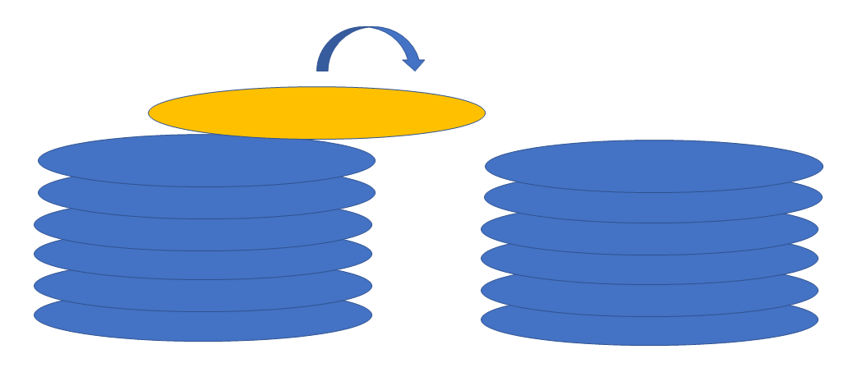
Introduction to Stack - Example
Insertion of a new plate on top of the pile of plates
Deletion of last inserted plate

Slide 6
Operations in Stack
The various primitive operations that are needed for stack are:
Initialization
Emptiness check
Insertion or Push
Deletion or Pop
Finding Stack Top element or Peek

Slide 7
Array Implementation of Stack
There are two elements in each stack
Array to store data (we are naming it as Data [ ])
Top (to store the index of the Top element)
If stack were declared with the name S, its elements would be represented as:
S.Top: representing the top pointing to the Last element inserted in Stack.
S.Data[ ]: is the buffer storing all the elements.

Slide 8
Stack Initialization
Every stack, before being used, should be initialized. Initialization must depict that the stack contains zero elements at the beginning.
For example, if we assume the array indices to vary from 0 to N-1 (where N is the array size), If Top is initialized to 0 index, it means an element is there at the 0th index.
Hence, we should initialize the Top to invalid index, say -1.

Slide 9
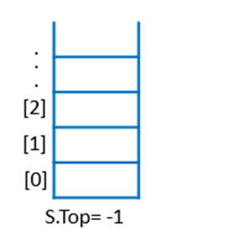
Stack Initialization
ALGORITHM InitializeStack(S)
Input: Stack S
Output: None
BEGIN:
S.Top = – 1
END;
Time Complexity: Time Complexity of this Operation is Ɵ(1) as there is only one statement to execute.
Space Complexity: Since there is no auxiliary space used in the algorithm, the space function is 0 (constant) i.e., the Space Complexity of this Operation is Ɵ (1).
Initializing Top at -1
Stack Initialization

Slide 10
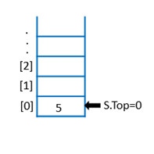
Emptiness Check
If the Top is -1, stack is empty.
ALGORITHM IsEmpty(S)
Input: Stack S
Output: True or False based on emptiness
BEGIN:
IF (S.Top == -1) THEN
RETURN TRUE
ELSE
RETURN FALSE END;
Time Complexity: Time Complexity of this Operation is Ɵ(1) as there are only two statements to execute.
Space Complexity: Since there is no auxiliary space used in the algorithm, the space function is 0 (constant) i.e., Space Complexity of this Operation is Ɵ (1).
S.Top=-1 indicates stack is empty
Empty Stack
Non Empty Stack

Slide 11
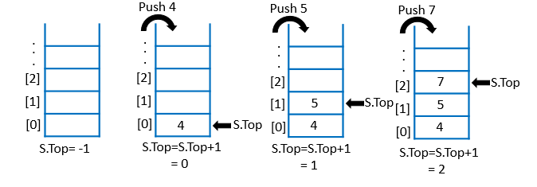
Stack Insertion
Insertion in stack is given a standard name ‘Push’. The figure given below shows the insertion process on the stack.
Insertion Process

Slide 12
Stack Insertion
Every time we have to insert an item in the stack, we must update the Top index.
We usually fix the Stack size (MaxSize e.g.) in array implementation.
If Top has reached the MaxSize – 1 index, i.e. the maximum possible index, further insertion will not be possible. We throw an exception “overflow” in this case.
Overflow: Consider a bucket where water is filled completely. If we pour more water in it, the water will overflow. Similarly, an attempt to insert an element in the full stack leads to the condition of overflow.

Slide 13
Stack Insertion
ALGORITHM Push (S, item)
Input: Stack S, data value ‘item’ to be inserted
Output: True or False based on emptiness
BEGIN :
IF S.Top == MaxSize – 1 THEN
WRITE(“Stack Overflows”)
EXIT(1)
ELSE
S.Top = S.Top + 1
S.Data[S.Top] = item
END;
Exit() is a function that is used to terminate the program. Parameter in the function can be 1,0 or any positive value. The value 0 indicates the normal termination and 1 indicates the termination under exceptional circumstances.
If no more insertion possible.
Increment in Top index by 1.
Insert the data item at the Top index of Stack.

Slide 14
Stack Insertion
Time Complexity: If the Overflow occurs, there will be one condition check plus two other statements to execute. If overflow does not take place, then one condition and two other statements will be executed. A total of 3 statements will be executed in both cases. Therefore, time Complexity of this Operation is constant i.e. Ɵ(1).
Space Complexity: Since there is no auxiliary space used in the algorithm, the space function is 0 (constant) i.e., Space Complexity of this Operation is Ɵ(1).

Slide 15
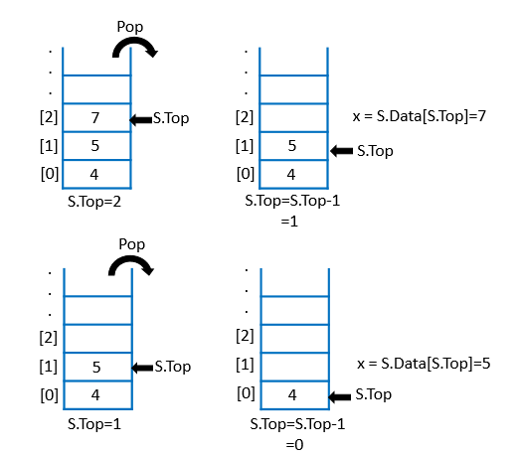
Deletion in a Stack
Deletion in stack is given a standard name ‘Pop’. This operation will be used for deletion of a data element from the stack. Figure given below shows the deletion process on the stack.

Slide 16
Deletion in a Stack
For performing the Pop operation, we need to check if the Stack is Empty.
Since an element cannot be deleted from the Empty Stack, the attempt to delete an element will lead to underflow condition.
While performing deletion, Top index of the stack will be decremented by 1.
Pop will return the deleted item to the calling function.

Slide 17
Deletion in a Stack
ALGORITHM Pop (S)
Input: Stack S
Output: Deleted item from top index of stack
BEGIN: IF S.Top == -1 THEN WRITE(“Stack Underflows”)
EXIT(1)
ELSE x = S.Data[S.Top]
S.Top = S.Top – 1
RETURN x
END;
Check Underflow condition
Saving the Top index element in x.
Decrement in Top index by 1.
Returning deleted item.

Slide 18
Deletion in a Stack
Time Complexity: If the underflow occurs, there will be one condition check plus two other statements to execute. If underflow does not take place, then one condition and three other statements will be executed. A total of 3 or 4 statements will be executed in both the cases. Therefore, time Complexity of this Operation is constant i.e. Ɵ(1).
Space Complexity: 1 extra variable is used in the algorithm named x, the space function is 1 (constant) i.e. Space Complexity of this Operation is Ɵ(1).

Slide 19
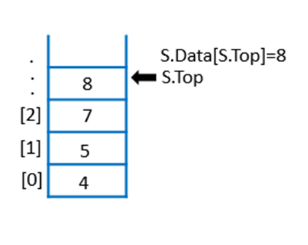
Finding the top element
ALGORITHM Peek (S)
Input: Stack S
Output: Top index element of Stack
BEGIN:
RETURN S.Data[S.Top]
END;
Time Complexity: Time Complexity of this Operation is Ɵ(1) as there is only one statement to execute.
Space Complexity: Since there is no auxiliary space used in the Algorithm, the space function is 0 (constant) i.e. Space Complexity of this Operation is Ɵ(1).
Reading and returning the top index element

Slide 20
The Order followed by stack data structure is
LIFO | B. Random
D. FIFO | C. None

Slide 21
What is the time complexity of Push and Pop operation in Stack?
O(1) for Push and O(n) for Pop. | B. O(n) for Push and O(n) for Pop.
D. O(1) for Push and O(1) for Pop. | C. O(n) for Push and O(1) for Pop.

Slide 22
Consider two stacks stored in the memory with the basic operations modified as follows: When a new element is pushed, the value is pushed into the first stack. The pop operation transfers all the elements of stack-1 to stack-2 and then pops the first element from the second stack. What will be the complexity of performing the pop operation?
O(1). | B. O(n).
D. O(log(n)). | C. O(n^2)

Slide 23
The following sequence of operation is performed on a stack S: PUSH(23), PUSH(34), PUSH(20), POP, POP, PUSH(54), PUSH(35), POP, POP, POP, PUSH(4), POP. The sequence of values popped out and the elements present at the top of stack after all these operations are.
A. 23, 34, 20, 54, 35, 4 and s[top] = NULL | B. 23, 34, 35, 54, 4 and s[top] = 20
D. 23, 54, 35, 34, 20 and s[top] = 4 | C. 20, 34, 35, 54, 23, 4 and s[top] = NULL

Slide 24
What will be the maximum size of stack used for performing the following sequence of operations? PUSH(23), PUSH(32), POP, PUSH(3), PUSH(45), POP, PUSH(1), POP, POP, PUSH(9) ?
A. 2 | B. 3
D. 1 | C. 4

Slide 25
Which of the following permutations can be obtained in the output (in the same order) using a stack assuming that the input is the sequence 2, 13, 46, 75, 19.
A. 46, 2, 13, 19 , 75. | B. 46, 19, 2, 13, 75.
D. 2, 46, 13, 19, 75. | C. 2, 75, 13, 46, 19.

Slide 26
Consider the following operation performed on a stack of size 7. Push(3); Pop(); Push(5); Push(1); Pop(); Push(10); Pop(); Pop(); Push(2); After the completion of all operation, the no of unfilled cell present on stack are
A. 1 | B. 2
D. 4 | C. 6

Slide 27
Consider the following pseudocode: declare a stack of characters while ( there are more characters in the word to read ) { read a character push the character on the stack } while ( the stack is not empty ) { write the stack's top character to the screen pop a character off the stack } What is written to the screen for the input "carpets"?
A. serc | B. carpets
D. steprac | C. ccaarrppeettss

Slide 28
Let there be a stack of integer values. How many elements does the stack contain after following operations PUSH(S, 1), PUSH(S, 2), … , PUSH(S, 10) Multipop(S, 5) PUSH(S, 11), PUSH(S, 12), … , PUSH(S, 30) Multipop(S, 10)
A. 20 | B. 30
D. 10 | C. 15

Slide 29
Applications of Stack

Slide 30
Number Conversion
Using stack, we can easily convert a decimal number to its equivalent Binary, Hexadecimal, Octal or a number in any desired base.
Step 1: Take the Modulus of number with 2.
Step 2: Push the remainder in Step 1 into a Stack.
Step 3: Divide the number by 2 and save the quotient in the same number.
Step 4: Repeat Step 1 to 3 until number becomes zero.
Step 5: Pop the Stack and display the popped item.
Step 6: Repeat Step 5 until Stack becomes empty.

Slide 31
ALGORITHM: DecimalToBinary (Decimal)
Input: A Decimal number
Output: Binary equivalent
BEGIN:
Stack S
InitializeStack(S)
WHILE Decimal != 0 DO
r = Decimal % 2
Push(S, r)
Decimal = Decimal / 2
WHILE !IsEmpty(S) DO
x = Pop(S)
WRITE(x)
END;
Finding the remainder.
Push the remainder into Stack.
Saving the quotient.
Printing the Stack elements until Stack is empty.

Slide 32
ALGORITHM: DecimalToHexadecimal(Decimal)
Input: A Decimal Number
Output: Equivalent Hexadecimal Number
BEGIN: Stack S
InitializeStack(S)
Arr[ ] = { ‘0’, ’1’, ‘2’, ‘3’ , ‘4’, ‘5’, ‘6’, ‘7’, ‘8’, ‘9’, ‘A’, ‘B’, ‘C’, ‘D’, ‘E’, ‘F’ }
WHILE Decimal!= 0 DO
r = Decimal % 16
Push(S, Arr[r])
Decimal = Decimal / 16
WHILE !IsEmpty(S) DO
x = Pop(S)
WRITE(x)
END;
Direct Address Table containing possible remainders in sequence
Finding the remainder.
Push the remainder into Stack.
Saving the quotient.
Printing the Stack elements until Stack is empty.

Slide 33
Reversal of String using Stack
We can simply reverse a string using stack. By reversing, we mean that if a string is "live" then when we read it from last, it will be "evil. "
Algorithm StringReverse (Str[])
Input: A String
Output: String in reverse order
Begin:
Stack S
i=0
WHILE Str[i] ! = ‘\0’ DO
Push(S, str[i])
i++
WHILE !IsEmpty(S) Do
x = Pop(S)
WRITE (x)
End;
Reading all elements present in string str[ ] one by one
and pushing them in the stack S
Printing the stack elements until Stack is empty.

Slide 34
Palindrome Check using Stack
A String is a palindrome if we read a string from left to right or right to left, both refers to the same string. That means the original and reversed strings are same. E.g. “madam”, “Kanak”.
ALGORITHM PalindromeCheck (Str[])
Input: A String
Output: Decision about string’s palindrome status
Begin:
Stack S
InitializeStack(S)
i=0
WHILE Str[i] ! = ‘\0’ DO
Push(S, str[i])
i++
j= 0
Reading all elements present in string str[ ] one by one
and pushing them in the stack S

Slide 35
Palindrome Check using Stack
WHILE !IsEmpty(S) Do
IF(Str[j]== Peek (S)) THEN
x = Pop(S)
ELSE
BREAK
j=j+1
IF IsEmpty(S) THEN
WRITE (“Palindrome”)
ELSE
WRITE (“Not Palindrome”)
End
If top element of stack is matched with current character of string,
Pop the element from Stack.
Terminate the process otherwise
Process is repeated till Stack becomes empty
If all characters have matched
If any character had a mismatch

Slide 36
Suppose we need to check whether a given string is palindrome or not. What will be the minimum number of comparisons required in order to check this?
A. Exactly n comparisons. | B. Exactly n-1 comparisons.
D. n/2 comparison. | C. None of these.

Slide 37
Which data structure is more appropriate to use while calculating factorial of a number using recursion?
A. Queue | B. Array
D. Stack | C. None of these.

Slide 38
Stack A has four values a, b, c, d which are inserted in reverse order with a at the top of the stack. Elements popped from stack A are pushed in Stack B. Determine the sequence that is not possible while popping out the elements from stack B?
A. a, b, c, d | B. d, c, b, a
D. d, b, c, a | C. a, c, b, d

Slide 39
declare a character stack while ( more input is available) { read a character if ( the character is a '(' ) push it on the stack else if ( the character is a ')' and the stack is not empty ) pop a character off the stack else print "unbalanced" and exit } print "balanced" Which of these unbalanced sequences does the above code think is balanced?
A. ((()) | B. ())(()
D. (()())) | C. (()))()

Slide 40
5.5 Inter-conversion and Evaluation of Polish Notation Expressions

Slide 41
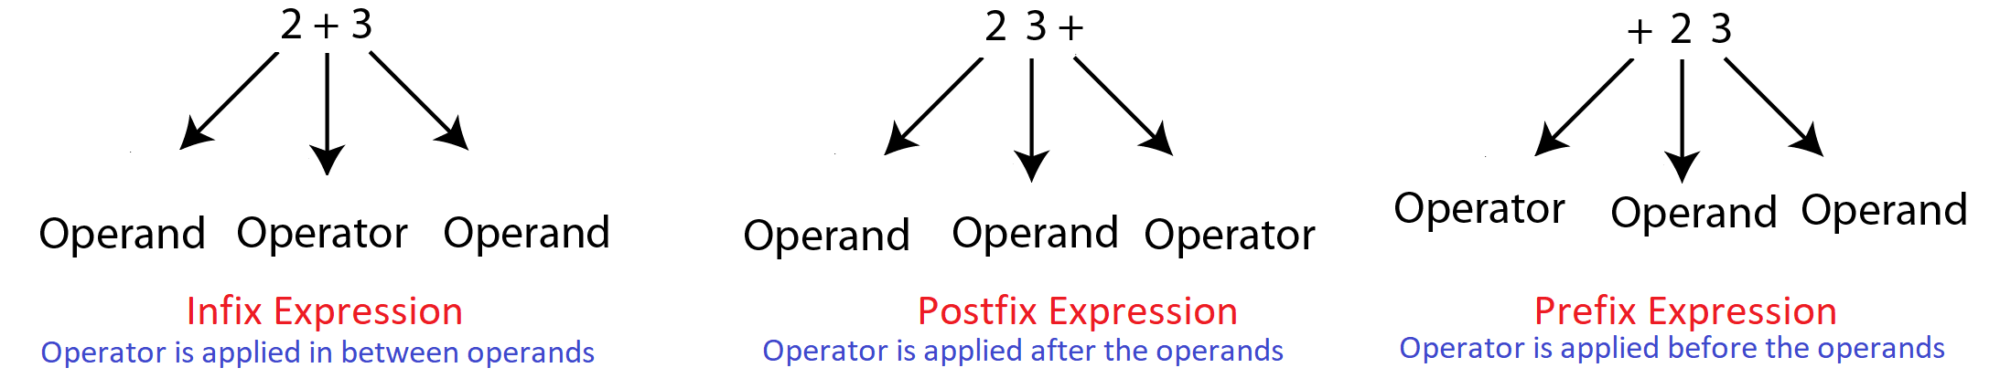
Types of Expression
Consider an expression x+y. Here x and y are the operands and + is the operator. There are three fashions in which an arithmetic expression can be written:
The above expressions denote the addition of operand 2 and operand 3.The Prefix is called Polish Notation, and Postfix is called Reverse Polish Notation.

Slide 42
5.5.1 Requirement of Polish/Reverse Polish Notation
Suppose we have been given an Infix expression:
2+5*6 – 8/4+3↑2 – (4/2)
To solve such expression, we need to traverse the entire expression to find which operator has the highest precedence. We need to go from Left to Right and Right to Left multiple times to evaluate the expression (according to BODMAS rule).
In case we are given another type of expression (Postfix), e.g., 897-*, if we solve this like:
If operands are observed, push this on the stack
If operators are observed, Pop the stack twice and store elements in b and a, respectively. Then, apply the operator on a and b and Push the result in the stack.
If no term left in the expression, the stack top element will be the result
In this case, we only need to move from Left to Right once. As soon as we reach the Right end, we have the answer.

Slide 43
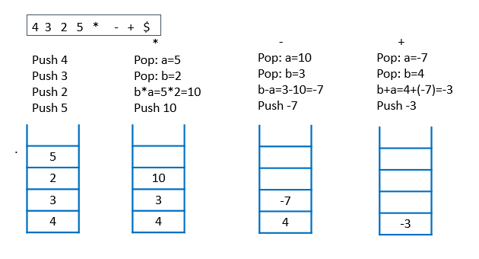
5.5.2 Evaluation of Postfix Expression
The precedence and associativity of operators are not required to be checked while evaluating the expression using stack.

Slide 44
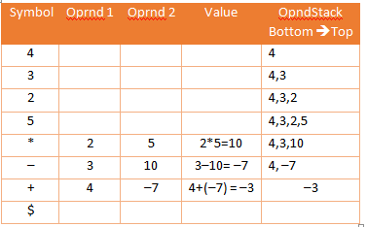
Continue..
Tabular method to represent the evaluation of Postfix Expression:
Example: 4 3 2 5 * – +
Value of the given Expression = –3

Slide 45
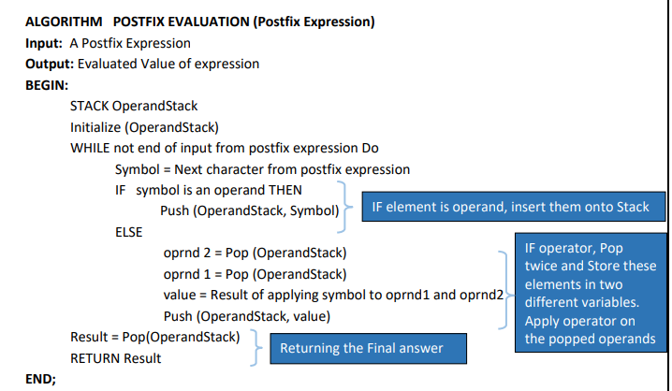
ALGORITHM POSTFIX EVALUATION (Postfix Expression)

Slide 46
Time & Space Complexity of Polish Expression
Time Complexity: ϴ(N)
There are N symbols in the Expression. For each symbol, decision is to be taken for Push or Pop. In the case of operand, 2 statement execution (including a condition) and for operator, 5 statement executions (including the condition) are required. There are N/2+1 IF element is operand, insert them onto Stack IF operator, Pop twice and Store these elements in two different variables. Apply operator on the popped operands Returning the Final answer operands and N/2 operators. There are 4 other statements outside the Loop which are compulsory. Hence total statements = 4 + (N/2+1) *2 + (N/2) *5 = 4+N+2+5*N/2 = 7*N/2+6 = ϴ(N)
Space Complexity: ϴ(N)
N/2+1 size stack is required and three variables for Symbol, value, and result. Total space=N/2+1+3=N/2+4

Slide 47
PUSH and POP operations for evaluation of postfix expression 4 3 2 ↑ * 6 – 8+ is
A. 9 PUSH, 8 POP | B. 5 PUSH, 4 POP
D. 5 PUSH, 9 POP | C. 9 PUSH, 9 POP

Slide 48
How many stack will be needed for the evaluation of a prefix expression
2 | B. 1
D. 0 | C. None of the above

Slide 49
Suppose the following postfix expression abc*de+*- is evaluated, what will be the value when first * is evaluated? Assume a = 3, b = 4, c = 2, d = 4, e = 5.
21 | B. 12
D. 18 | C. None of the above

Slide 50
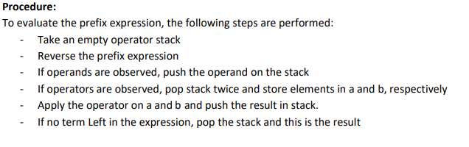
5.5.3 Evaluation of Prefix Expression

Slide 51
Procedure: To evaluate the prefix expression
T he following steps are performed: -
Take an empty operator stack
Reverse the prefix expression
If operands are observed, push the operand on the stack
If operators are observed, pop stack twice and store elements in a and b, respectively
Apply the operator on a and b and push the result in stack.
If no term Left in the expression, pop the stack and this is the result

Slide 52
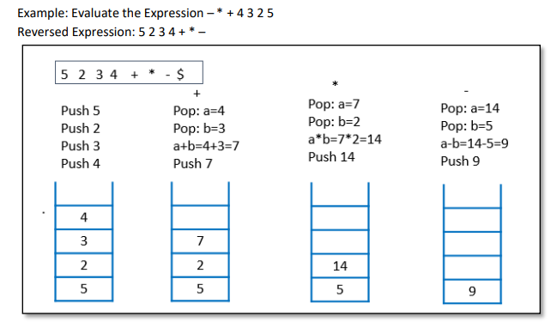
Continued…

Slide 53
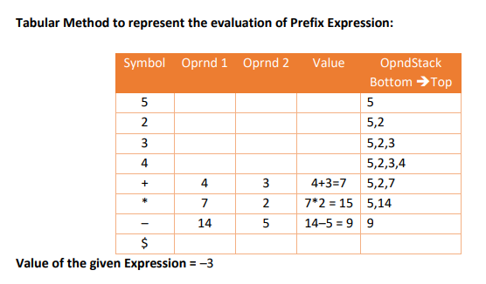
Continued...

Slide 54
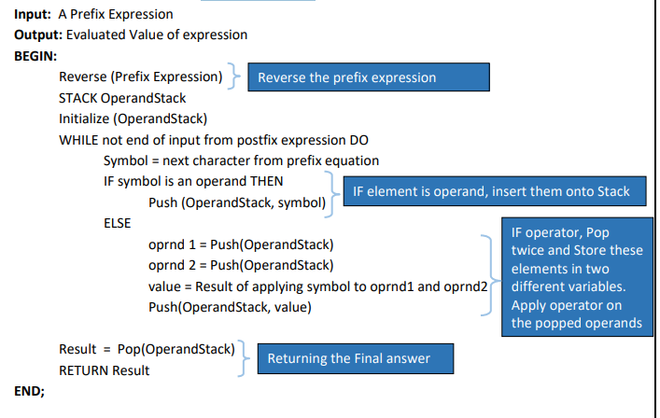
ALGORITHM PrefixEvaluation (Prefix Expression)

Slide 55
Time & Space Complexity of Prefix Expression
Time Complexity: ϴ(N)
Reverse will take ϴ(N) time with any approach. There are N symbols in the Expression. For each symbol, decision is to be taken for Push or Pop. There are N/2+1 operands and N/2 operators. There are 4 other statements outside the Loop which are compulsory.
Hence total statements = C*N+4 + (N/2+1) *2 + (N/2) *5 = ϴ(N)
Space Complexity: ϴ(N)
N/2+1 size stack is required and three variables for symbol, value, and result. For reversing the string another N size stack is required.
Total space=N+N/2+1+3=3N/2+4

Slide 56
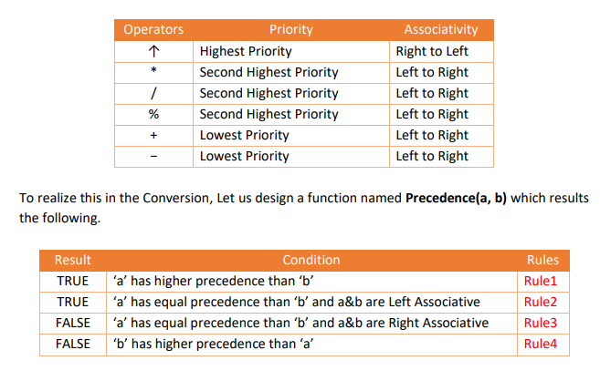
5.5.4 Infix to Postfix Conversion
To convert the given Infix expression to Postfix Expression, let us re-write the Precedence and Associativity rules.
Precedence and Associativity Rules for Arithmetic Operators:

Slide 57
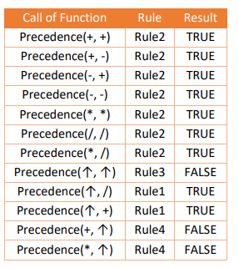
Continued..

Slide 58
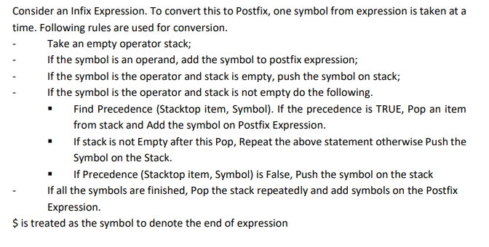
Continued..

Slide 59
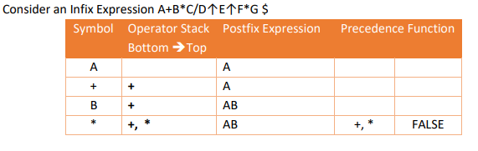
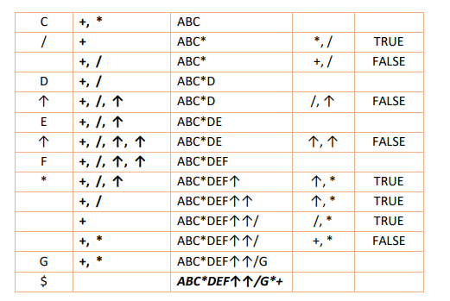
Tabular Method for Conversion of Infix Expression to Postfix

Slide 60
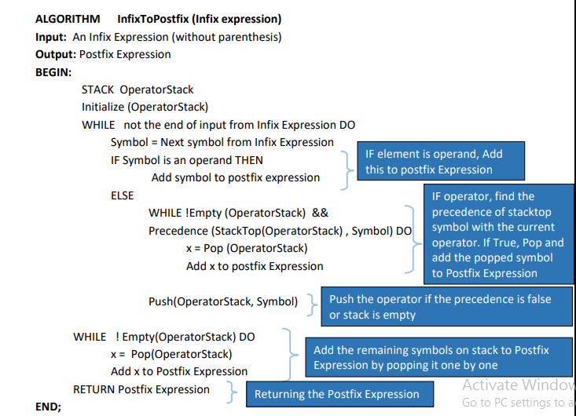
Algorithm Infix to Postfix

Slide 61
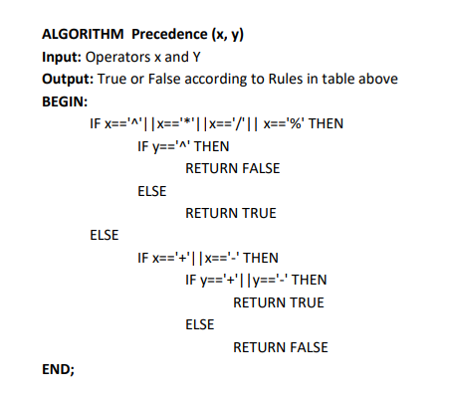
Algorithm for precedence

Slide 62
Time & Space Complexity of Infix to Postfix
Time Complexity: ϴ(N)
For any symbol, there are two decisions to make. If the symbol is an operand two statement is required to be executed (including condition). In case of operator, 3 statements in case the loop condition is true otherwise 1 statement for Push. Overall there are N symbols for which decision has to be made. The statement execution required are in the order of N.
Space Complexity: ϴ(N)
The operator stack is required which will be of size N/2. Some other variables are required that can be treated as constant space. Total space complexity in this case will be in the order of N.

Slide 63
Which among the following algorithms requires reversing the input string before processing through stacks?
A. Infix to postfix conversion | B. Infix to prefix conversion
D. Postfix evaluation | C. None of these

Slide 64
Which among the following algorithm requires application of stacks (directly or indirectly)
A. Quick sort | B. Heap sort
D. Selection sort | C. Bubble sort

Slide 65
Assume that the operators +,−,× are left associative and ^ is right associative. The order of precedence (from highest to lowest) is ^, ×, +, −. The postfix expression corresponding to the infix expression a – b × c + d ^ e ^ f is?
A. abc-xde^+f^ | B. a+b×c-d^e^f^+
D. abcx-def^^+ | C. abcx-de^f^+

Slide 66
Let there be a stack of integer values. How many elements does the stack contain after following operations PUSH(S, 1), PUSH(S, 2), … , PUSH(S, 10) Multipop(S, 5) PUSH(S, 11), PUSH(S, 12), … , PUSH(S, 30) Multipop(S, 10)
A. 20 | B. 30
D. 10 | C. 15

Slide 67
Here is an infix expression: 4+3*(6*3-2). Suppose that we are using the usual stack algorithm to convert the expression from infix to postfix notation. What is the maximum number of symbols that will appear on the stack AT ONE TIME during the conversion of this expression?
A. 1 | B. 2
D. 3 | C. 4

Slide 68
Postfix Equivalent of A↑B↑C↑D↑E is
A. ABCDE↑↑↑↑ | B. AB↑C↑D↑E↑
D. ABC↑↑DE↑↑ | C. ABCD↑↑↑E↑

Slide 69
5.5.4.2 Dealing with Infix Expression with Parentheses
Precedence rules needs to be extended for the parenthesis.
Recall the Precedence function with parameters a and b.
If a is the opening parenthesis (, precedence results false;
If b is the opening parenthesis (, precedence results false;
If b is the closing parenthesis), precedence results true;
If a is opening parenthesis and b is closing parenthesis, precedence results False (This is a special case false in which stack is Popped but Popped symbol is discarded).

Slide 70
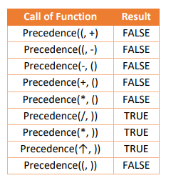
Continue…

Slide 71
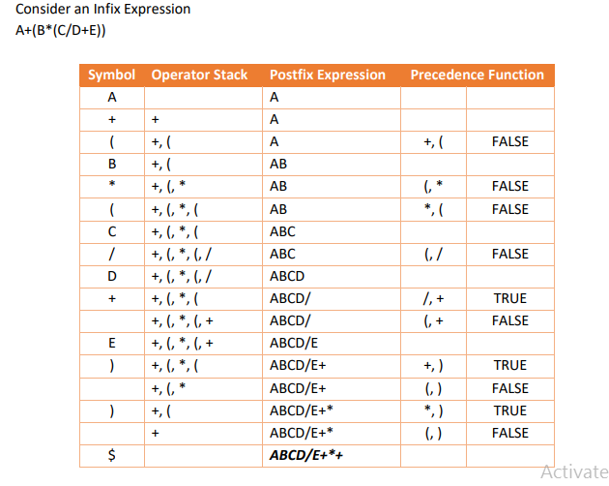
Continue,..

Slide 72
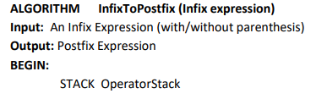
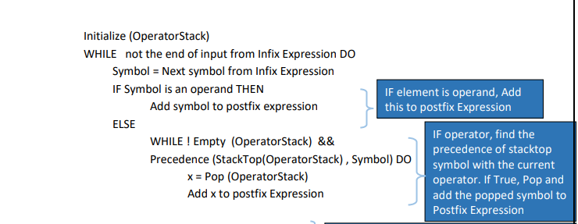
Algorithm Infix to Postfix Expression

Slide 73
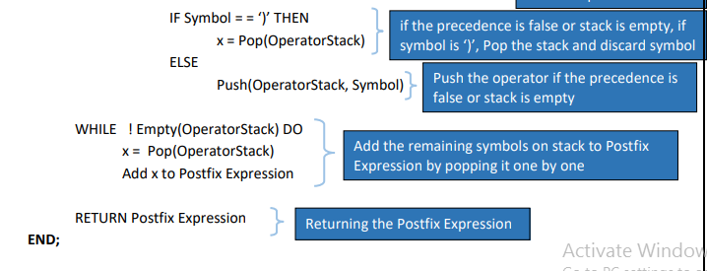
Algorithm Infix to Postfix Expression

Slide 74
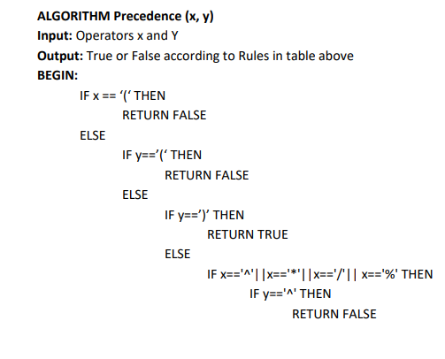
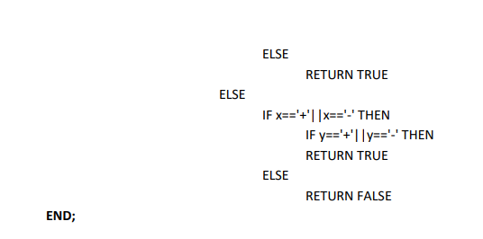
Algorithm to check Precedence

Slide 75
5.5.5 Infix to Prefix Conversion
Consider an Infix Expression. To convert this to Prefix, following rules are used
Reverse the infix expression.
Take an empty operator stack.
If the symbol is an operand, add the symbol to prefix expression.
If the symbol is the operator and stack is empty, push the symbol on stack.
If the symbol is the operator and stack is not Empty do the following:
▪ Find Precedence (Symbol, StackTop item). If the precedence is FALSE, Pop an item from stack and add the symbol on Prefix Expression.
▪ If stack is not Empty after this Pop, Repeat the above statement again otherwise Push the Symbol on the Stack.
▪ If Precedence (Stacktop item, Symbol) is True, Push the symbol on the stack - If all the symbols are finished, pop the stack repeatedly and add symbols on the Postfix expression.
- Reverse the prefix expression

Slide 76
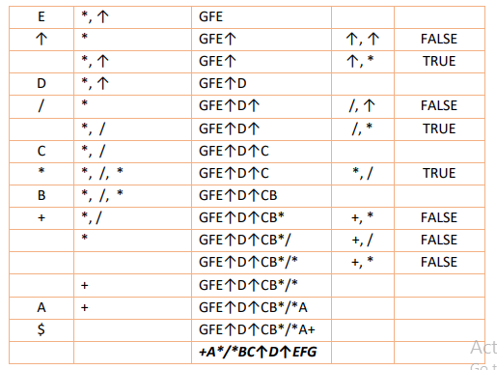
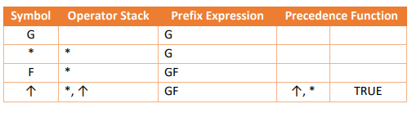
Tabular Method for Conversion of Infix Expression to Prefix
Consider the Infix Expression: A+B*C/D↑E↑F*G
Expression after reverse G*F↑E↑D/C*B+A

Slide 77
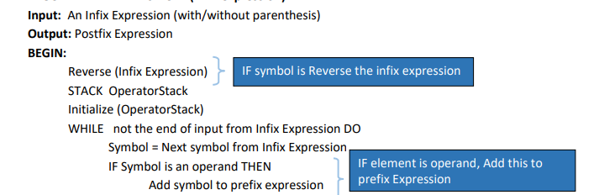
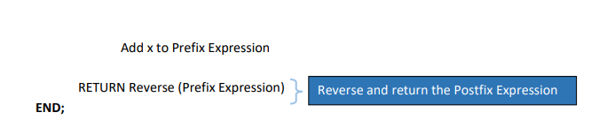
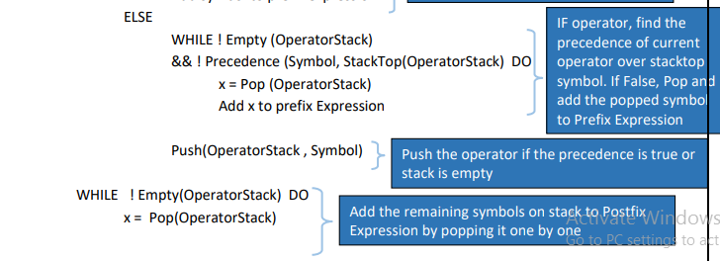
Algorithm infix to prefix conversion

Slide 78
Time Complexity: ϴ(N)
The reverse is done twice in the logic requiring 2*CN effort. For any symbol, there are two decisions to make. If the symbol is an operand two statement is required to be executed (including condition). In case of operator, 3 statements in case the loop condition is true otherwise 1 statement for Push. Overall there are N symbols for which decision has to be made. The statement execution required are in the order of N.
Space Complexity: ϴ(N)
The operator stack is required here which will be of size N/2. Some other variables are required that can be treated as constant space. Total space complexity in this case will be in the order of N.

Slide 79
Which of the following applications may use a stack?
A. A parenthesis balancing program. | B. Keeping track of local variables at run time.
D. Syntax analyzer for a compiler. | C. All of the above.

Slide 80
The postfix form of the expression (A+ B)*(C*D- E)*F / G is?
A. AB+ CD*E - FG /** . | B. AB + CD* E - F **G /
D. AB + CD* E - *F *G / | C. AB + CDE * - * F *G /

Slide 81
The prefix form of an infix expression p + q - r * t is?
A. + pq - *rt . | B. - + pqr * t
D. - + pq * rt | C. - + * pqrt

Slide 82
Sorting a STACK

Slide 83
Sort a Stack
Here it is assumed that the elements are given in the stack. A process is applied to sort and store the numbers in the new stack. The procedure goes like this:
1. Take an empty temporary stack
2. Take an element out from the input stack, say a
3. The element a is compared with the top of the temporary stack (say b). If b is greater than a,
Element is Popped from temporary stack (say c)
c is pushed on the input stack
Step 3 is repeated until the condition is true
4. a is pushed on temporary stack
5. 2,3,4 are repeated until there are no elements in Input stack
6. Temporary stack is returned as the answer

Slide 84
ALGORTHM SortingUsingStack(STACK Input)
Input: An input stack
Output: sorted stack
BEGIN: Stack TmpStack
Initialize(TmpStack)
WHILE !IsEmpty(Input) Do
a = Pop(Input)
WHILE !Empty(TmpStack) AND StackTop(TmpStack) > a DO
C = Pop(TmpStack)
Push(Input, C)
Push(TmpStack, a)
RETURN TmpStack
END;

Slide 85
Time Complexity: O(N²)
There are N symbols on the stack and stack is already reverse sorted, The effort required will be 1+2+3+…+N i.e. N(N+1)/2 i.e. O(N²). This is the worst case.
The best case appears when the input stack is reverse sorted. In this case the effort required will be in the order of N i.e. Ω(N).

Slide 86
Space Complexity: ϴ(N)
A stack of size N is required in this case plus some variables that amounts to constant space. Total space required hence is in the order of N.

Slide 87
Finding minimum from the stack

Slide 88
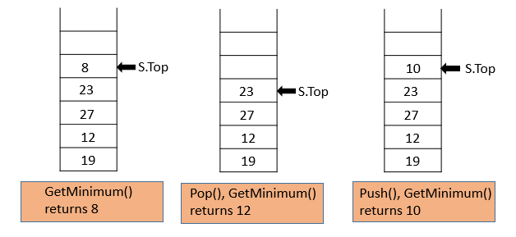
Finding minimum from the stack
Apart from the usual primitive operations on the stack, we may be interested in finding additional information, e.g. Minimum or Maximum among all the elements.
The same requires the traversal i.e. O(N) time with the traditional ways.
So let us redefine the primitive operations such that finding minimum elements too requires O(1) time and space.

Slide 89
Method 1: Temporary Stack
Take a Temporary empty stack.
Set the top element as Minimum.
Pop element from the original stack while making the comparison with minimum element (update the Minimum element in case the current element is smaller than minimum).
Push the element in the Temporary stack.
Repeat 3,4 until original stack is empty.
Pop element from the Temporary stack.
Push the element in the Original stack.
Repeat 5, 6 until the Temporary stack is empty.
Return the Minimum Element.

Slide 90
ALGORITHM MinimumFromStack(Stack S)
Input: A Stack
Output: Minimum Element
BEGIN:
Stack Temp
Initialize(Temp)
Min = StackTop(S)
WHILE !Empty(S) DO
X=Pop(S)
IF X<Min THEN
Min = X
Push(Tmp, X)
WHILE !Empty(Tmp) DO
X=Pop(Tmp)
Push(S, X)
RETURN Min
END;

Slide 91
Complexity
Time Complexity:
The entire stack needs to be shifted to temporary stack and restored another time. There are 2N Push and 2N Pop operations required in this case. Total 4N*O(N) time is required plus some constant time operations. Total effort hence is ϴ(N).
Space Complexity:
A temporary stack here will amount to N space plus a minimum variable that will cause constant space. Total space is ϴ(N).

Slide 92
Method 2
As method 1 is costly in terms of time and space, we can use the alternate method. In this we can use a temporary stack.
When the Push and Pop operations are performed, the minimum element is stored as the top element in the temporary stack.
The top of the Temporary stack always contains the minimum element.
Push and Pop need to be redefined as given below.

Slide 93
ALGORITHM Push(S,T,x)
Input: A Stack S, Temporary Stack T, Element x to be inserted
Output: None
BEGIN:
S.Top=S.Top+1
S.Item[S.Top]=x
IF Empty(T) THEN
T.Top=T.Top+1
T.Item[T.Top] = x
ELSE
IF StackTop(T) > x THEN
T.Top = T.Top+1
T.Item[T.Top] = x
ELSE
Y=T.Item[T.Top] T.Item[T.Top] = x T.Top=T.Top+1
T.Item[T.Top] = y
END;

Slide 94
ALGORITHM Pop(S,T)
Input: A Stack S, Temporary Stack T
Output: Deleted Element
BEGIN:
X = S.Item[S.Top]
S.Top=S.Top-1
IF X == StackTop(T) THEN
T.Top = T.Top-1
END;

Slide 95
ALGORITHM FindMinimum(T)
Input: A Stack T
Output: Minimum Element
BEGIN:
RETURN T.Item[T.Top]
END;
Time and Space Complexity:
This approach requires O(1) time for Push, Pop and find Minimum and O(N) space. Thus, N represents the number of elements currently.

Slide 96
Method 3
This method thinks of manipulating the data before storage. This approach requires only O(1) time and space.
A variable Minimum is taken that always stores the minimum from the stack. This variable is modified upon each Push and Pop operation.
If the minimum element is removed with the Pop operation, Minimum element needs to change.
To handle this, we push “2*x – Minimum" into the stack instead of x so that the previous minimum element can be retrieved using the current minimum and its value stored in stack.

Slide 97
Push(x)
1. If the stack is empty, insert X into the stack and make Minimum equal to X.
2. If stack is not empty, compare X with Minimum element. There may be two cases here.
If X is greater than or equal to Minimum, insert X.
If X is smaller than Minimum, insert (2*X – Minimum) into the stack and make Minimum equal to X.

Slide 98
Pop() :
1. Remove element from top and store it in X.
2. If X is greater than or equal to Minimum, the minimum element remains the same.
3. If X is less than Minimum, the minimum element now becomes (2*Minimum – X), so update (Minimum = 2*Minimum – X).

Slide 99
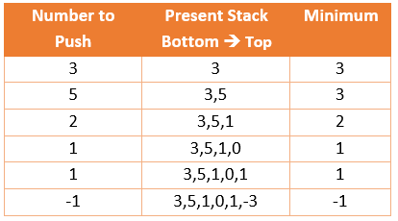
Illustration of Sequence of Push Operations

Slide 100
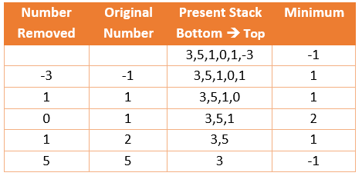
Illustration of Sequence of Pop Operations

Slide 101
Implementing multiple Stacks in a single Array
Logical division of the Array in the equal-sized chunks (No of chunks equal to no of
desired stacks)
Sharing of memory regions of Array by 2 Stacks
Method 1 can be utilized for many stacks; method 2 can be used only for 2 stacks.

Slide 102
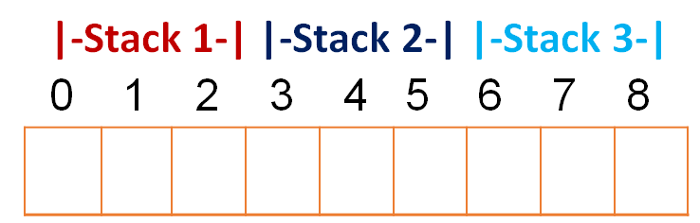
Implementing multiple Stacks in a single Array
Method 1: Logical division of Array
A single Array will store multiple stacks. Therefore, there will be a different Top for each stack in that Array (Top1, Top2, …)
Let Array size (N) =9
Number of stack (M) =3
Size of each stack = N/M =9/3=3

Slide 103
Implementing multiple Stacks in a single Array
Stack 1 has indexes 0,1,2
Stack 2 has indexes 3,4,5
Stack 3 has indexes 6,7,8
If N=8, then stack size = N/M = 2.6. This is unacceptable as size cannot be in a fraction. Hence, we select the sizes as 3,3,2.
consider the stack numbering as 0, 1, 2, …
For stack 0, initial top = 0 * 3 -1 = -1
For stack 1, initial top = 1 * 3 -1 = 2
For stack 2, initial top = 2 * 3 -1 = 5
For stack i, initial top = i * N/M -1

Slide 104
Implementing multiple Stacks in a single Array
Generalized push operations in the i^{th} Stack:
If the top of i^{th} stack reaches to the upper limit, this will indicate the condition of overflow. Overflow occurs at (i+1)*N/M -1.
If Array size (N) is 15
No of stacks (M) = 3
Slots for Stack 0 are 0,1,2,3,4
Slots for Stack 1 are 5,6,7,8,9
Slots for Stack 2 are 10,11,12,13,14
Overflow for stack 0 will occur if Top has reached (0+1)*15/3 – 1 = 4
Overflow for stack 1 will occur if Top has reached (1+1)*15/3 – 1 = 9
Overflow for stack 0 will occur if Top has reached (2+1)*15/3 – 1 = 14

Slide 105
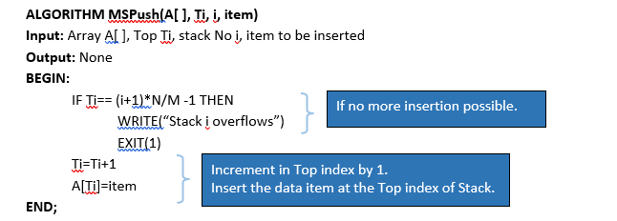
Implementing multiple Stacks in a single Array

Slide 106
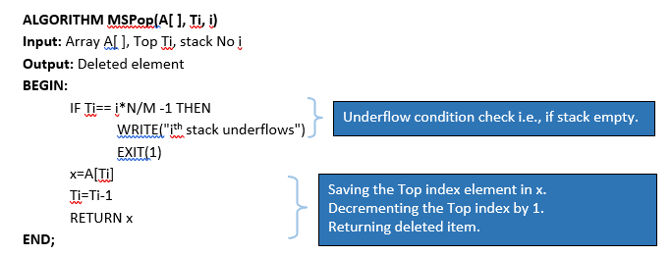
Implementing multiple Stacks in a single Array
Generalized pop operations in the i^{th} Stack, We should decide about the underflow condition. If the Top of i^{th} stack reaches the initialized Top, this will indicate underflow condition. Underflow occurs at (i)*N/M -1.

Slide 107
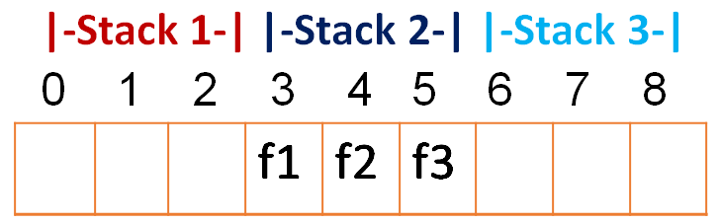
Implementing multiple Stacks in a single Array
Advantage of Multiple Stack single array (MSSA)
Better memory utilization as compared to using single stack.
Multiple Recursive programs can be designed considering partitioned array with defined boundaries.
Drawback of Multiple Stack single Array (MSSA)
Consider the given situation:
A lot of space is empty in stack1 and stack3. Stack 2 is full as per the given computations. In case we run the Push Algorithm for stack 2, it will result in overflow. Hence MSSA can be referred to as inefficient.

Slide 108
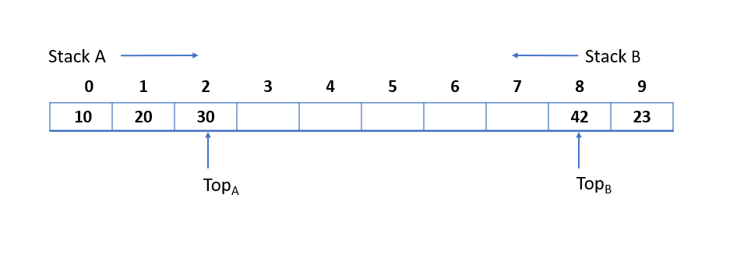
Implementing multiple Stacks in a single Array
Method 2: Sharing of Array memory by two Stacks
NOTE: one stack will start from left and other will start from right. For Push, in the first stack, Top will be incremented. For Push, in the second stack, Top will be decremented.
Let there be an array A[N] divided into two stacks Stack A, Stack B.
Stack A expands from left to right, i.e. from 0th index onwards.
Stack B expands from right to left, i.e, from (N-1)^{th} index to backward.
The combined size of both Stack A and Stack B never exceeds N.
Both Stacks are full when Top_{A} = Top_{B} – 1.
Both Stacks are empty when Top_{A} = – 1 & Top_{B} = N.

Slide 109
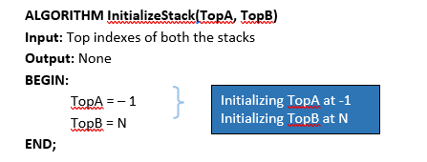
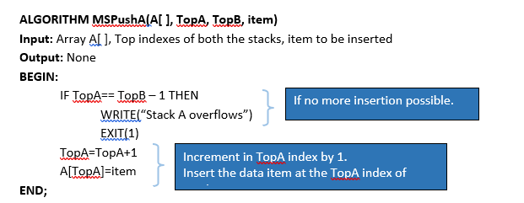
Implementing multiple Stacks in a single Array

Slide 110
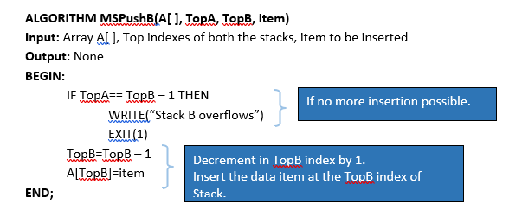
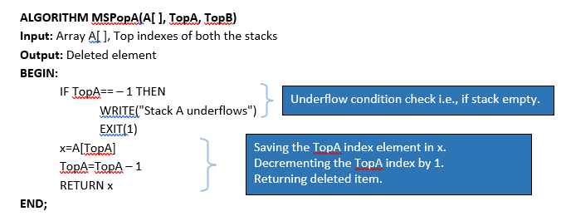
Implementing multiple Stacks in a single Array

Slide 111
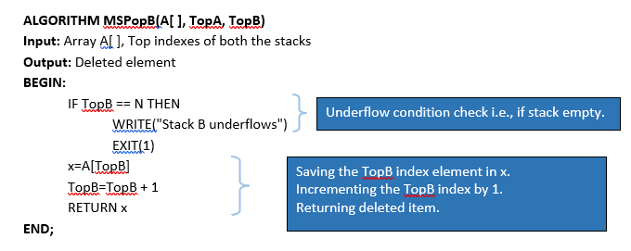
Implementing multiple Stacks in a single Array

Slide 112
Implementing multiple Stacks in a single Array
Logical division of the Array in the equal-sized chunks (No of chunks equal to no of
desired stacks)
Sharing of memory regions of Array by 2 Stacks
Method 1 can be utilized for many stacks; method 2 can be used only for 2 stacks.

Slide 113
Implementing multiple Stacks in a single Array
Method 1: Logical division of Array
A single Array will store multiple stacks. Therefore, there will be a different Top for each stack in that Array (Top1, Top2, …)
Let Array size (N) =9
Number of stack (M) =3
Size of each stack = N/M =9/3=3

Slide 114
Implementing multiple Stacks in a single Array
Stack 1 has indexes 0,1,2
Stack 2 has indexes 3,4,5
Stack 3 has indexes 6,7,8
If N=8, then stack size = N/M = 2.6. This is unacceptable as size cannot be in a fraction. Hence, we select the sizes as 3,3,2.
consider the stack numbering as 0, 1, 2, …
For stack 0, initial top = 0 * 3 -1 = -1
For stack 1, initial top = 1 * 3 -1 = 2
For stack 2, initial top = 2 * 3 -1 = 5
For stack i, initial top = i * N/M -1

Slide 115
Implementing multiple Stacks in a single Array
Generalized push operations in the i^{th} Stack:
If the top of i^{th} stack reaches to the upper limit, this will indicate the condition of overflow. Overflow occurs at (i+1)*N/M -1.
If Array size (N) is 15
No of stacks (M) = 3
Slots for Stack 0 are 0,1,2,3,4
Slots for Stack 1 are 5,6,7,8,9
Slots for Stack 2 are 10,11,12,13,14
Overflow for stack 0 will occur if Top has reached (0+1)*15/3 – 1 = 4
Overflow for stack 1 will occur if Top has reached (1+1)*15/3 – 1 = 9
Overflow for stack 0 will occur if Top has reached (2+1)*15/3 – 1 = 14

Slide 116
Implementing multiple Stacks in a single Array

Slide 117
Implementing multiple Stacks in a single Array
Generalized pop operations in the i^{th} Stack, We should decide about the underflow condition. If the Top of i^{th} stack reaches the initialized Top, this will indicate underflow condition. Underflow occurs at (i)*N/M -1.

Slide 118
Implementing multiple Stacks in a single Array
Advantage of Multiple Stack single array (MSSA)
Better memory utilization as compared to using single stack.
Multiple Recursive programs can be designed considering partitioned array with defined boundaries.
Drawback of Multiple Stack single Array (MSSA)
Consider the given situation:
A lot of space is empty in stack1 and stack3. Stack 2 is full as per the given computations. In case we run the Push Algorithm for stack 2, it will result in overflow. Hence MSSA can be referred to as inefficient.

Slide 119
Implementing multiple Stacks in a single Array
Method 2: Sharing of Array memory by two Stacks
NOTE: one stack will start from left and other will start from right. For Push, in the first stack, Top will be incremented. For Push, in the second stack, Top will be decremented.
Let there be an array A[N] divided into two stacks Stack A, Stack B.
Stack A expands from left to right, i.e. from 0th index onwards.
Stack B expands from right to left, i.e, from (N-1)^{th} index to backward.
The combined size of both Stack A and Stack B never exceeds N.
Both Stacks are full when Top_{A} = Top_{B} – 1.
Both Stacks are empty when Top_{A} = – 1 & Top_{B} = N.

Slide 120
Implementing multiple Stacks in a single Array

Slide 121
Implementing multiple Stacks in a single Array

Slide 122
Implementing multiple Stacks in a single Array

Slide 123
Can you answer these questions?

